Slide 1
Internet and Web Technology Lab ICT- 2206 Lecture - 16
Presented By:
Mehrin Anannya
Lecturer
Institute of Information Technology
Jahangirnagar University.

Slide 2
Contents
Version Control
VCS and their operations
Centralized VCS
Distributed VCS
Git
GitHub
Hands on Practice

Slide 3
Version Control
A system for managing changes made to documents and other computer files.
What kinds of files can we use it with?
Source code
Documentation
Short stories
Binary files (music and pictures)
What should we use it for?
Source code
Text files
Projects that have lots of revisions (changes)
Collaborating

Slide 4
VCS and their Operation
Lots of different choices available:
CVS
SVN
Perforce
Git
Mercurial (Hg)
Bazaar
And more!
Most follow a repository model (though differ in how the repositories work)

Slide 5
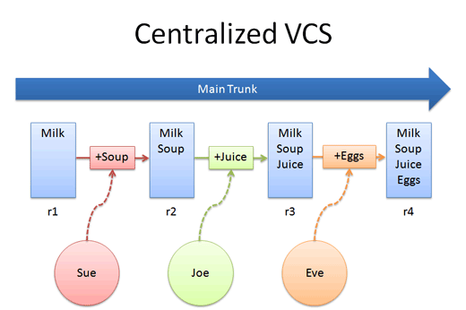

Slide 6
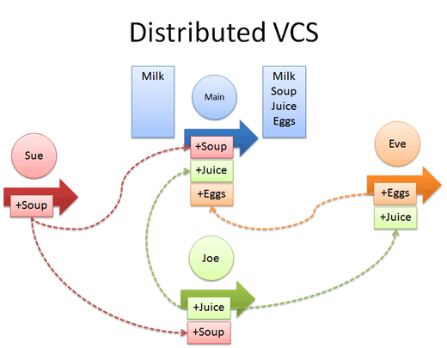

Slide 7
Git

Slide 8
Git Introduction
Git is a distributed version control system that allows developers to track changes in their computer files and work in collaboration with other developers.
It was created by Linus Torvalds, the creator of Linux, in 2005 for allowing other developers to contribute towards the Linux kernel.
Distributed version control system means that there is not a single repository centralizing all the code history. All the code history is in each repository, which means that you have all the history in your local repository as well as in the others.
It is known for amazing functions such as speed, simple and easy to use design, support for non-linear development, full distribution and ability to handle large projects with efficiency.
Though acronym of Git shows as global information tracker but Linus named it by its meaning - ‘an unpleasant or contemptible person’

Slide 9
Advantages of Git
Free and Open Source
Fast & Small
Backup
Easier Branching

Slide 10
Git Repositories
Local repository: one on which we will make local changes, typically this local repository is on our computer.
keywords : commit, branche, merge, rebase, etc.
Remote repository: one of the server, typically a machine situated at 42 miles away. The purpose of a remote repository (e.g. - GitHub) is to publish your code to the world (or to some people) and allow them to read or write it.
The remote repository is involved when you git push your local commits to remote repo & git pull when someone else’s commits from it.

Slide 11
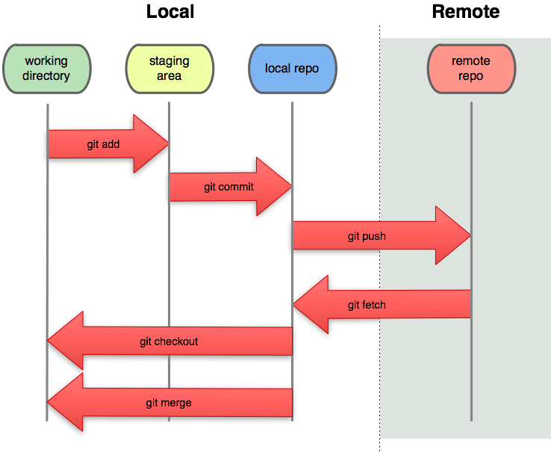
Git working procedure
git pull

Slide 12
GitHub

Slide 13
GitHub Introduction
A web-based Git repository hosting service, that offers all the functions of distributed version control and source code management (SCM) functionality found in Git, as well as adds more.
It is commonly used in collaboration with Git and allows developers to save their coding online and then collaborate with other developers on different projects.
GitHub also provides access control, plus also collaboration functions such as bug tracking, feature requests, task management, and wikis for every project.
The objective of GitHub, and what it is marketed as, is to simply promote collaborations between developers, allowing them to get a new set of ideas on the project.

Slide 14
GitHub Features
Share your repositories with others.
Access other user's repositories.
Store remote copies of your repositories (github servers) as backup of your local copies.

Slide 15
Comparison with SVN
In the SVN analogy, Git replaces SVN, while GitHub replaces SourceForge.
The key difference is that it is decentralized. Imagine you are a developer on the road, you develop on your laptop and you want to have source control so that you can go back 3 hours.
With Subversion, you have a Problem: The SVN Repository may be in a location you can't reach (in your company, and you don't have internet at the moment), you cannot commit. If you want to make a copy of your code, you have to literally copy/paste it.
With Git, you do not have this problem. Your local copy is a repository, and you can commit to it and get all benefits of source control. When you regain connectivity to the main repository, you can commit against it.

Slide 16
Hands on Practice

Slide 17
Hands on Practice Contents
Account creation in GitHub
Download eclipse and ready to use
Create a repository in GitHub
Add the Github repository perspective in eclipse
Clone the repository in eclipse
Add eclipsed project to GitHub repository
How to commit, pull and push

Slide 18
Account creation in GitHub
Go to https://github.com/login
Create an account

Slide 19
Download eclipse
Sign in to https://www.eclipse.org/downloads/
Select the installer
After its installation, select the desired eclipse IDE
The install

Slide 20
Create a repository in GitHub
Sign in to https://github.com/login
Create a token (Settings > Developer Settings > Personal access tokens). It has to be used for authentication while doing push pull.
If there is Start A project then select that or click the Repositories and click the New button.
Give the repository name in which you will keep the project folder.
Press the Create repository button.
After its creation copy the created link.

Slide 21
Add the Githuib repository perspective in Eclipse
In the top right corner search box write the Git repository and select that.
Then after its addition in the lower left corner.
Select the Clone a Git repository.
Then in URI paste the copied clone url(https://github.com/Mehrin-Anannya/ICT-2206-repo.git) from github here.
Give the username and password.
Then hit the finish.
Then its local repository is ready to work here to get upload from here to the github repository.

Slide 22
Add eclipsed project to GitHub repository
Create a Dynamic Web Project: File > New > Web > Dynamic Web Project > give a name > Finish
Select the project > Configure > Convert into Maven project (Maven will be taught in the next slide)
Add Dependencies in pom.xml (4 dependencies)

Slide 23
How to commit, push and pull in GitHub?
Select the project > Right click on it > Team > Share Project > Configure Git Repository > From Repository dropdown select your repository > Finish
Commit and push: Commit the project in the repository: Select the project > Team >Commit > From Unstaged Changes select the files and drag and drop in the staged changes > Add comment > Commit and push / Commit > Push to branch in remote > Preview/ Next > Give login credentials (you can check the store for future credential check)
Pull: Team > Pull Request

Slide 24


